Slide 1



Welcome to Foxconn Vietnam
ALT Mr. SH Son
KEITI Mr. Donghoon Kim, Jiyoung Kim
H.I.Pathway Mr.Sung Mo Yeon
Wifi: Foxconn-GUEST
Password: Foxconn@QC!
Bac Giang: 2023.Aug.01st

Slide 2

Agenda
Time | Place | Check Points | Owner | Remark
09:00-09:15 | HCM meeting room | Welcome customer to visit Fii and review agenda | An Tran, Roisy, ME Cheng Lun, IE Heng
09:15-09:45 |  | Presentation of Fii and Factory introduction | An Tran
09:45-11:00 |  | Review data sheet for LCA | An Tran, Roisy, ME Cheng Lun, IE Heng
13:00-15:00 |  | Discuss about SMT use electric power | An Tran, Roisy, ME Cheng Lun, IE Heng
15:00-16:00 |  | Discuss about FATP use electric power | An Tran, Roisy, ME Cheng Lun, IE Heng
16:00-16:30 |  | Close meeting | An Tran, Roisy, ME Cheng Lun, IE Heng

Slide 3





About Foxconn Industrial Internet
Foxconn Vietnam Introduction
Quality Control
AGENDA
Supply Chain and Logistic Overview
Foxconn Vietnam CSR

Slide 4



























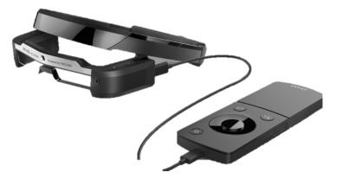



About Foxconn Industrial Internet
Overview
Global Footprint Network
Foxconn Industrial Internet (Fii) is a world's leading professional design and manufacturing service provider of communication network equipment, cloud service equipment, precision tools and industrial robots, providing customers with intelligent manufacturing services for new forms of electronic equipment products centered on the industrial Internet platform.
EMEA
Hungary
Czech Republic
Slovakia
East Asia
Tokyo, JP
Osaka, JP
Beijing, CN
Long Hua, CN
Nanning, CN
Song Jiang, CN
Hong Kong
Taipei, TW
HsinChu, TW
North America
Wisconsin, US
San Jose, CA
Santa Clara, CA
Houston, TX
Juarez, Mexico
10+
Automated Unmanned Factories
11+
Countries
Lighthouse
Factory
Certification
Revenue
$USD 68 Billion
South Asia
Chennai, India
South America
Manaus, Brazil
Southeast Asia
Bac Ning, VN
Bac Giang, VN
GZ, VN
Revenue
$USD 182 Billion
Terry Kuo
Founder
Yang-Wei Liu
Chairman
Brand Cheng
Fii CEO
190,000+
Employees
6,400+
Patents
Fii/CPEG Product Overview
5G Module
5G MiFi
5G IDU/DTU/ODU
5G Small Cell
5G Automative
WiFi AP/Mesh
PON
OTT Box/Dongle
Acoustics + IPTV
AR/VR
Notes:
Foxconn Revenue
Fii – Serveurs 40%/Infrastructure 30%/ Equipment reseau et communication 30%
Footprint : Employees, location, brevets
CPEG – Gamme de produit – 5G/Point d’acces/routeur/Mesh/PON/boitier OTT/audio video
Nouvelles tech : AR/VR

Slide 5




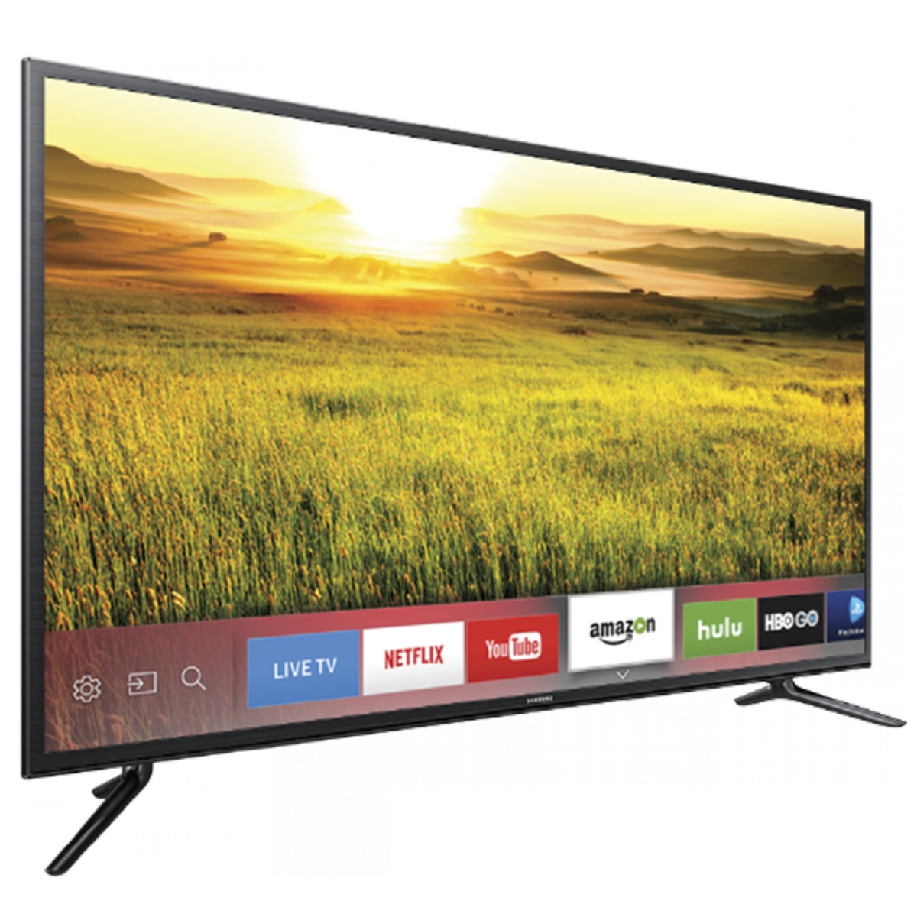









About Foxconn Industrial Internet
The Organization of Foxconn Group
A
B
C
D
E
S
FG(Fii)
Smartphone
Wearable
Tablet
Notebook
Mechanical
Component
Automation
Industrial 4.0
Smart Office
PC
Smart TV and Wall
Game Console
Robot
Semi-conductor
IC Design
Cloud Computing
Network Devices
OTT Devices
Smart Audio
History of Fii
Project team assemble
for the industrial internet
Fii platform makes its debuts at Beijing Industrial Internet Alliance Conference
Go to the public
in China Stock Market
Invested $40M USD in
machine vision development
2014
2016
2018
2020
2013
2015
2017
2019
The Concept of Fii
comes into being
Foxconn announced to build an "Industrial Internet Ecosystem”
Alliance of Industrial Internet
China Mobile IoT Alliance
Customization Industry Alliance
LIGHTHOUSE FACTORIES has been selected as one of the World Economic Forum (WEF)'s community of "Lighthouses Network"

Slide 6








Fii : Smart Manufacturing Service Provider
Foxconn Industrial Internet Co., Ltd. (Fii) was listed on A-share in 2018. With the strategy of "Data-driven and Green Development", its business has covered five categories of digital economy industry, including Cloud and edge computing, Industrial Internet, 5G and network communication, smart phones and wearable devices.
2018-2022 Revenue income statement
Ranked 1st
Electronic manufacturing service industry
USD billion
USD 73.3B
Total revenue in 2022
6,400 +
Number of patents
190,000+
Global employees
6
World-class Lighthouse factories
10
National / provincial Green factories
Firstly broke hundred billion in 1st season of 2022, the 3rd season increased 24.24%
Ranked 1st in net profit of listed companies in the IT industry of Guangdong in China
10+
Fully automatic smart factories

Slide 7

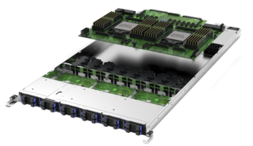
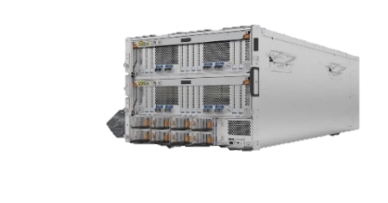
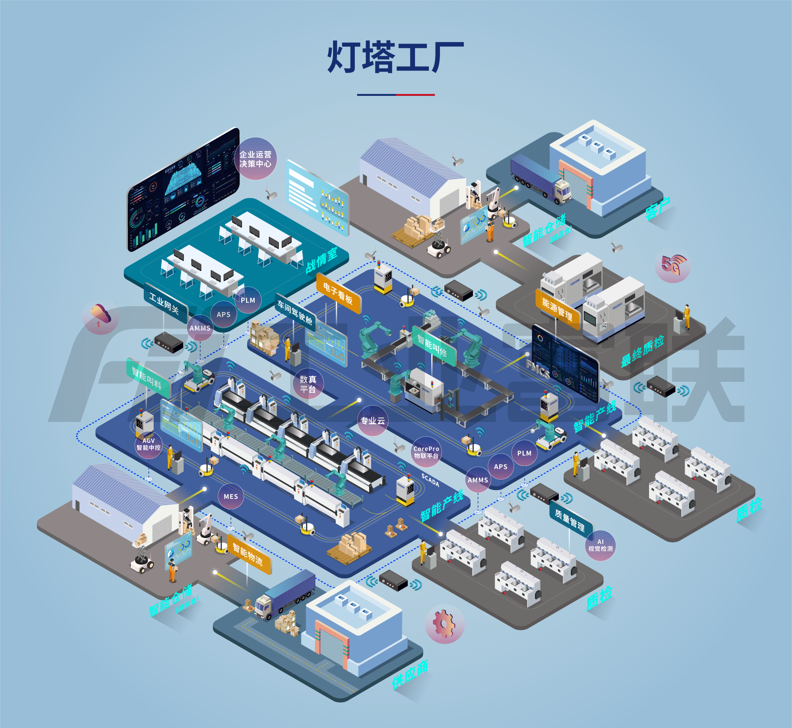
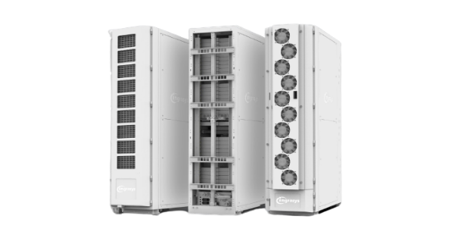
Core Business
Fii’s revenue share by segment in 2022: Communication and Mobile Network Equipment: USD$43B (58%) ; Cloud Computing: USD$31B (41%) ; Industrial Internet: USD$0.3B (<1%)
Network
Cloud
Industrial Internet
Enterprise network equipment include the router, wireless network market occupy rate
exceed 30%
Cloud Computing, enterprise server, memory,
market occupy rate exceed 40%
Lighthouse factory overall solution,
hard and soft integrated products,
cloud and platform service,
one station type
Scenario application
Digital base
IoT hardware
(Internet of Things)

Slide 8


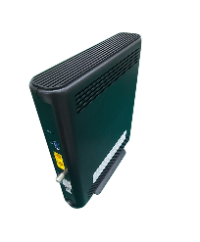
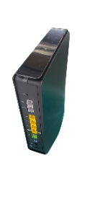

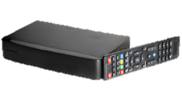




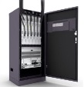

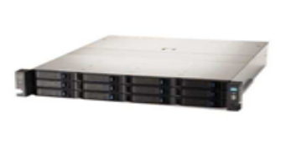
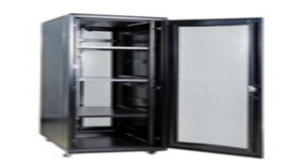


Network and Cloud Core Business
Communication Network Equipment
Cloud Service Equipment
Server & Storage：
Global market share >40%
Networking Equipment：
Global market share >30%
Switch
Router
Set Top Box
Modem
GPON
Telecommunications Equipment：
Global market share >20%
Optical
Transmission
equipment
Server
Data center equipment
Storage
Mobile base
station
High-precision mechanical components for communication network equipment
High-precision mechanical components for networking & telecommunications equipment
High-precision mechanical components for cloud service equipment

Slide 9
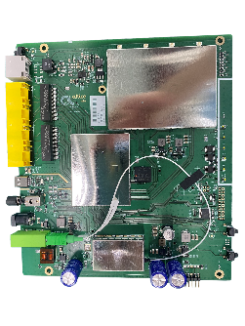
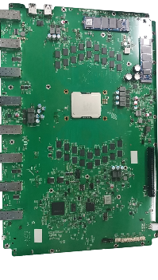
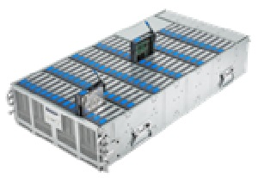
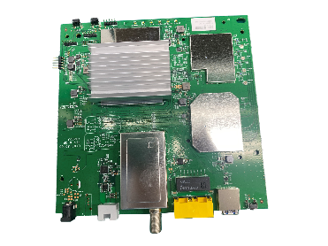

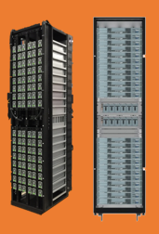
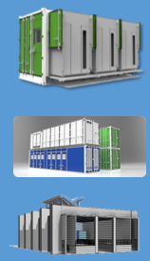

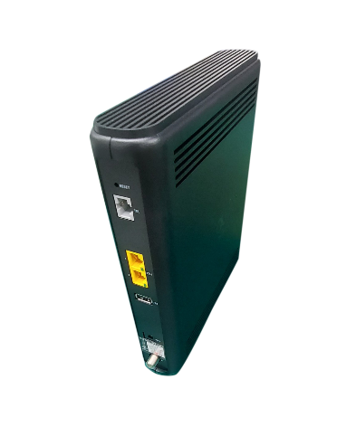


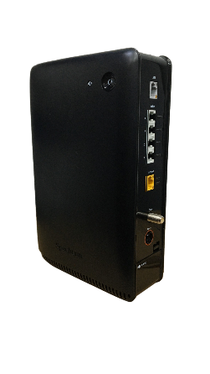
Highly-Integrated Production
_{Products}
_{Level}
L3/L5/L6
Board, Chassis, Rail
L10
Server, Storage Array, Switch, Router, Modem, GPON
Rack
Rack Integration & Assembly
Data Center

Slide 10
About Foxconn Industrial Internet
Foxconn Vietnam Introduction
Quality Control
AGENDA
Supply Chain and Logistic Overview
Foxconn Vietnam CSR

Slide 11
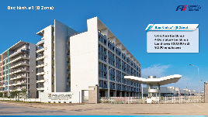

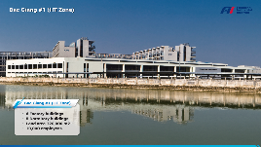

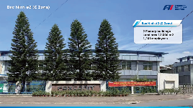
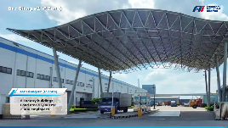
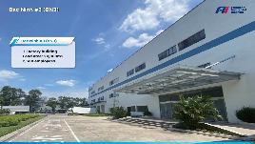
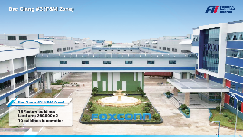
Fii in Vietnam - Bac Ninh & Bac Giang Campus
Bac Ninh #1
(B Zone)
Bac Giang #1
(HT Zone)
Capital : Hanoi
Population : 99 Million (2022)
Labor Force : 57 Million (2022)
Area : 331,410 km2
GDP : 271.2B USD (2021)
GDP Growth : 8% (2022)
6 buildings
Land area 120,000m²
2,396 employees
6 buildings
Land area 120,000m²
10,000 employees
Highlight of Vietnam
58% population are labor force, stable political system
Bac Ninh #2
(C Zone)
Bac Giang #2
(P Zone)
Low inflation and
continuously GDP growth
Strong FDI inflows and strong manufacturing sector
2 buildings
Land area 12,000m²
1,200 employees
5 buildings
Land area 55,000m²
2,000 employees
Bac Ninh #3
(BN3 Zone)
Bac Giang #3
(F & M Zone)
Fii Vietnam Over View
Operating Land Area 587,000m2 with total of 32 buildings and 26,863 active personnel
Bac Ninh Plant Over View
Operating Land Area 152,000m2
9 buildings
6,096 active personnel
Bac Giang Plant Over View
Operating Land Area 435,000m2
23 buildings
20,767 active personnel
1 buildings
Land area 20,000m²
2,500 employees
12 buildings
8,767 employees / Land area 260,000m²

Slide 12
Fii Vietnam - Headcounts and Demographics
Total Employees : 26,863 people:
Bac Ninh Site: 6,096 people
Bac Giang Site: 20,767 people
Key Data:
Age: workforce staff, 74% under 30 years old
Gender: Female vs. Male is 50% : 50%
Education: 18.3% major engineers and office staff hold College’s degree
Working Hour for VN factory:
Day shift: 07:30-16:15 Overtime 16:30-18:30
Night shift: 19:30-04:05 Overtime 04:15-06:15
Launch/Dinner Break: 1hr
Working Days: 6 days per week

Slide 13

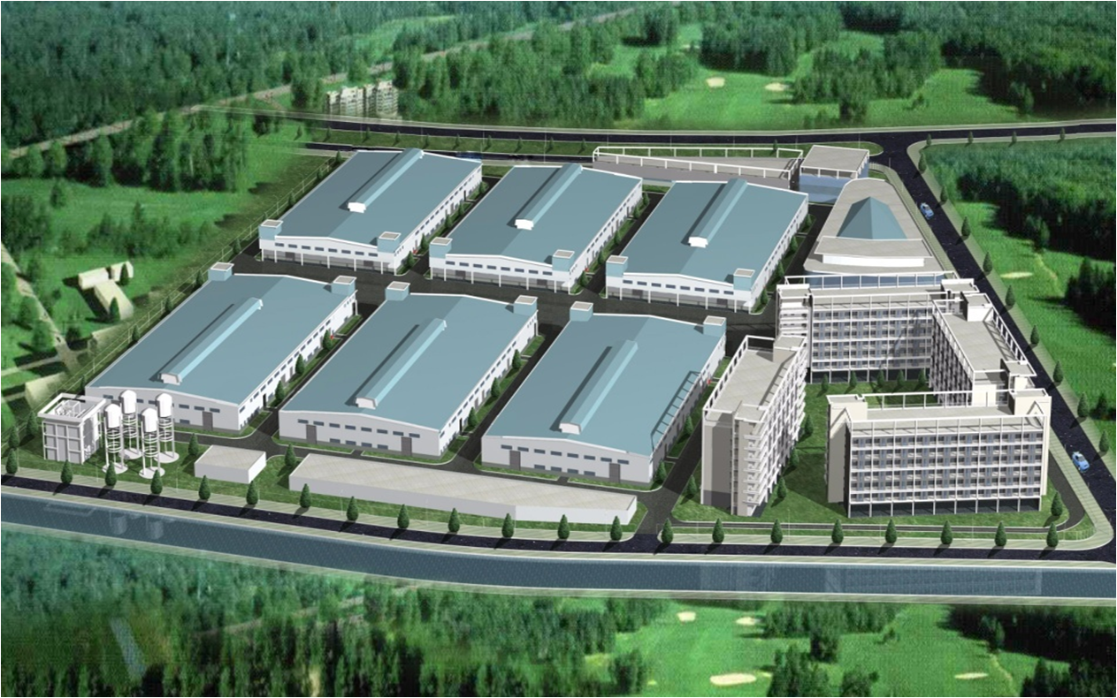
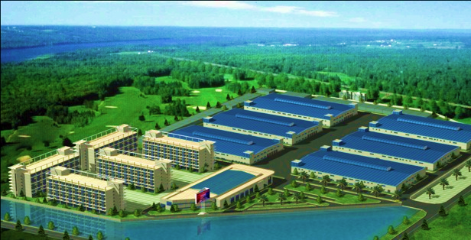
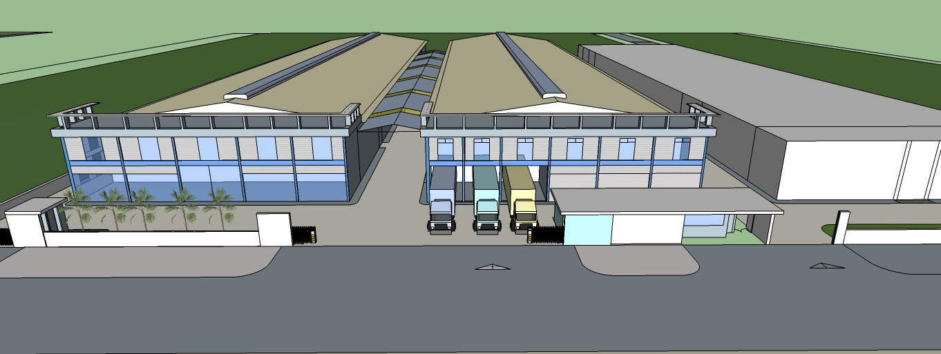
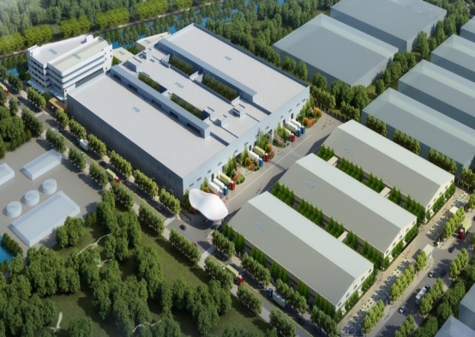
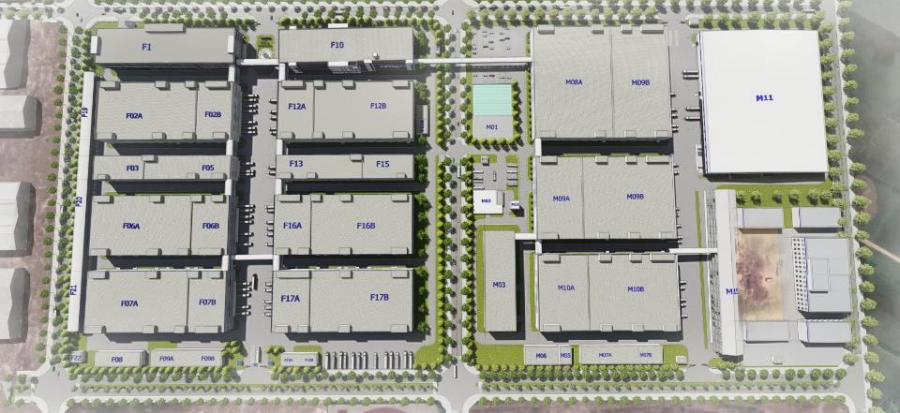
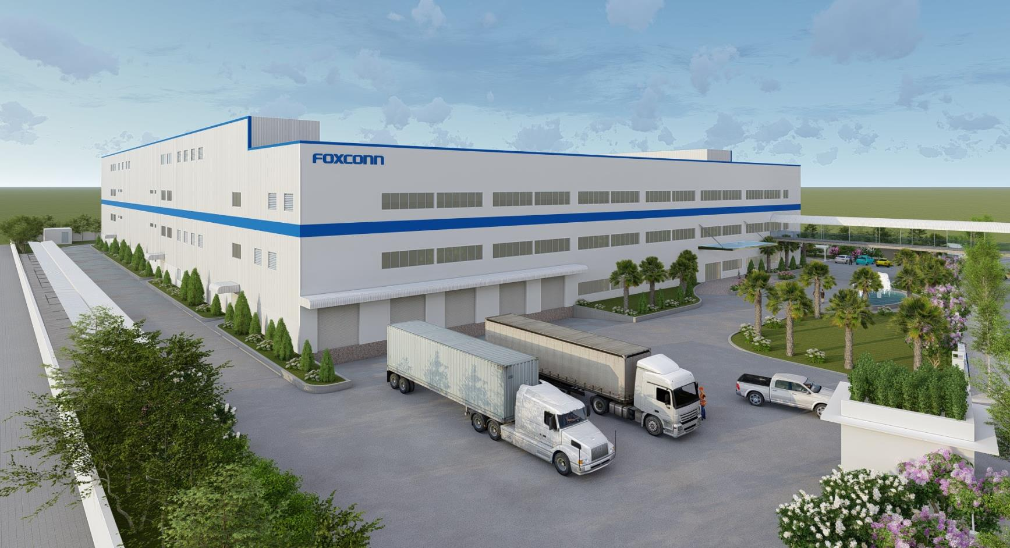
Foxconn VN Fii – Bac Ninh & Bac Giang Campus- 29 buildings
Bac Ninh #1
(B Zone)
Bac Giang #1
B03
B02
B01
6 Factory buildings
5 Dormitory buildings
Land area 120,000 m2
Production area: 65,000m2
Fii : 32,500m2
10,000 employees (Fii: 4,500 employees)
A03
6 Factory buildings
4 Dormitory buildings
Land area 120,000 m2
Production area: 68,400m2
Fii : 55,500m2
9,500 employees (Fii : 8500)
A02
B03
B06
B05
B04
A01
B02
B01
Bac Giang #2
(P Zone)
P05
Bac Ninh #2
(C Zone)
C03
C02
P06
P05A
5 Factory buildings
Land area 55,000 m2
Production area: 52,000m2
2,000 employees
P01
2 Factory buildings
Land area 12,000 m2
Production area: 13,000m2
1,200 employees
P02
P03
Bac Giang #3
(F&M Zone)
Bac Ninh #3
(BN3)
BN3
Total planning 12 Factory buildings
Land area 260,000m2
6 Factory buildings production on going
M zone building under construction
(M08/ M09/ M10)
Total production area: 310,000m2
1 Factory building
Land area: 20,000m2
Production area: 31,000m2
2,500 employees
13

Slide 14
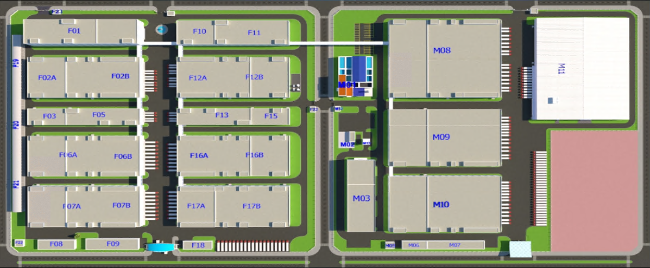
Foxconn VN Fii – Quang Chau Zone M&F
IQC/
Warehouse
Ubee materials
(M11)
We are here
SMT/PTH
FATP here
Key Summary F Zone:
Total Production Area : 260,000 M²
Total SMT Line : 103 Lines
Total employees : 16,000
Current location for production
M11 (IQC / Warehouse)

Slide 15
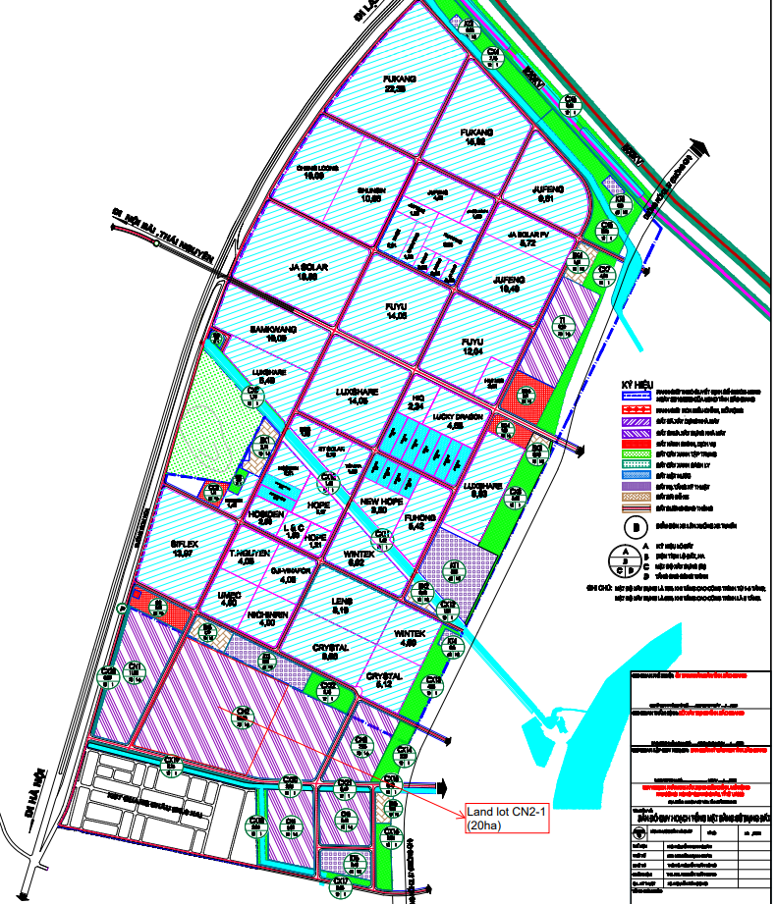
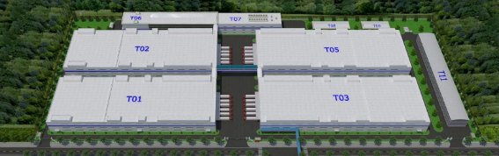
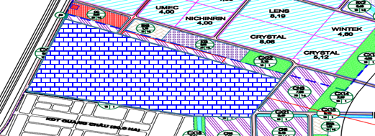
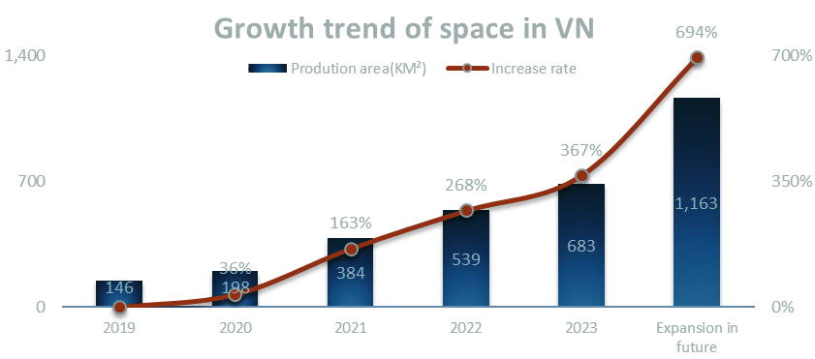
Foxconn Fii Vietnam – Site Expansion Plan in Guang Zhou
The Manpower & SMT scale
1. The current scale of employee has reached to 29,000, and it has increased 235% compare to 2019.
2. The current scale of SMT has reached to 173 lines.
Zone T1 (Open*4 Building)
Land area 87,735 m²
Floor area 143,730 m² to be available in Q4Y23
Zone F&M
We are here
Zone CN1&2 (Expansion)
Land area 480,000 m² acquired for expansion
694% ⇧

Slide 16
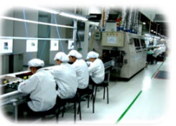
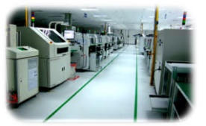
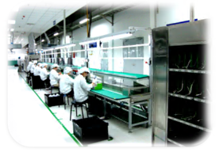
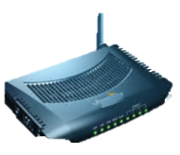

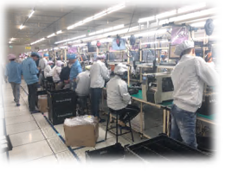
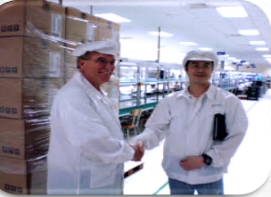
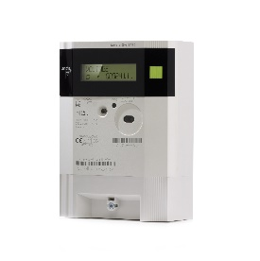
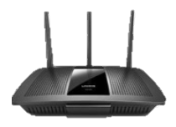
Fii Vietnam History (1/2)
2007
Foxconn starts to invest in North Vietnam
Vietnam Bac Giang Site starts operation
2010
In April 2010, we started operating for xDSL and cable modem.
2011
Vietnam Bac Ninh Site starts operation
we officially started production for xDSL products. In May 2011, we also started the production of smart meter.
STB, WiFi Router and Cable Modem production
we established a professional set-top box production
we started operating in Bac Ninh factory to manufacture WiFi Router and Cable Modem products.
2012
Established 4G and GPON product lines
2015
we kicked-off manufacturing 4G product (MiFi & Outdoor ODU), and in September, the GPON product line was launched for mass production

Slide 17


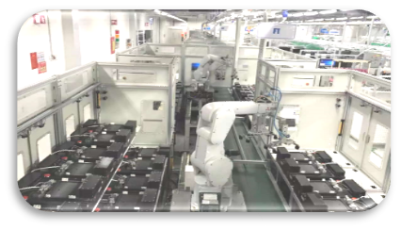
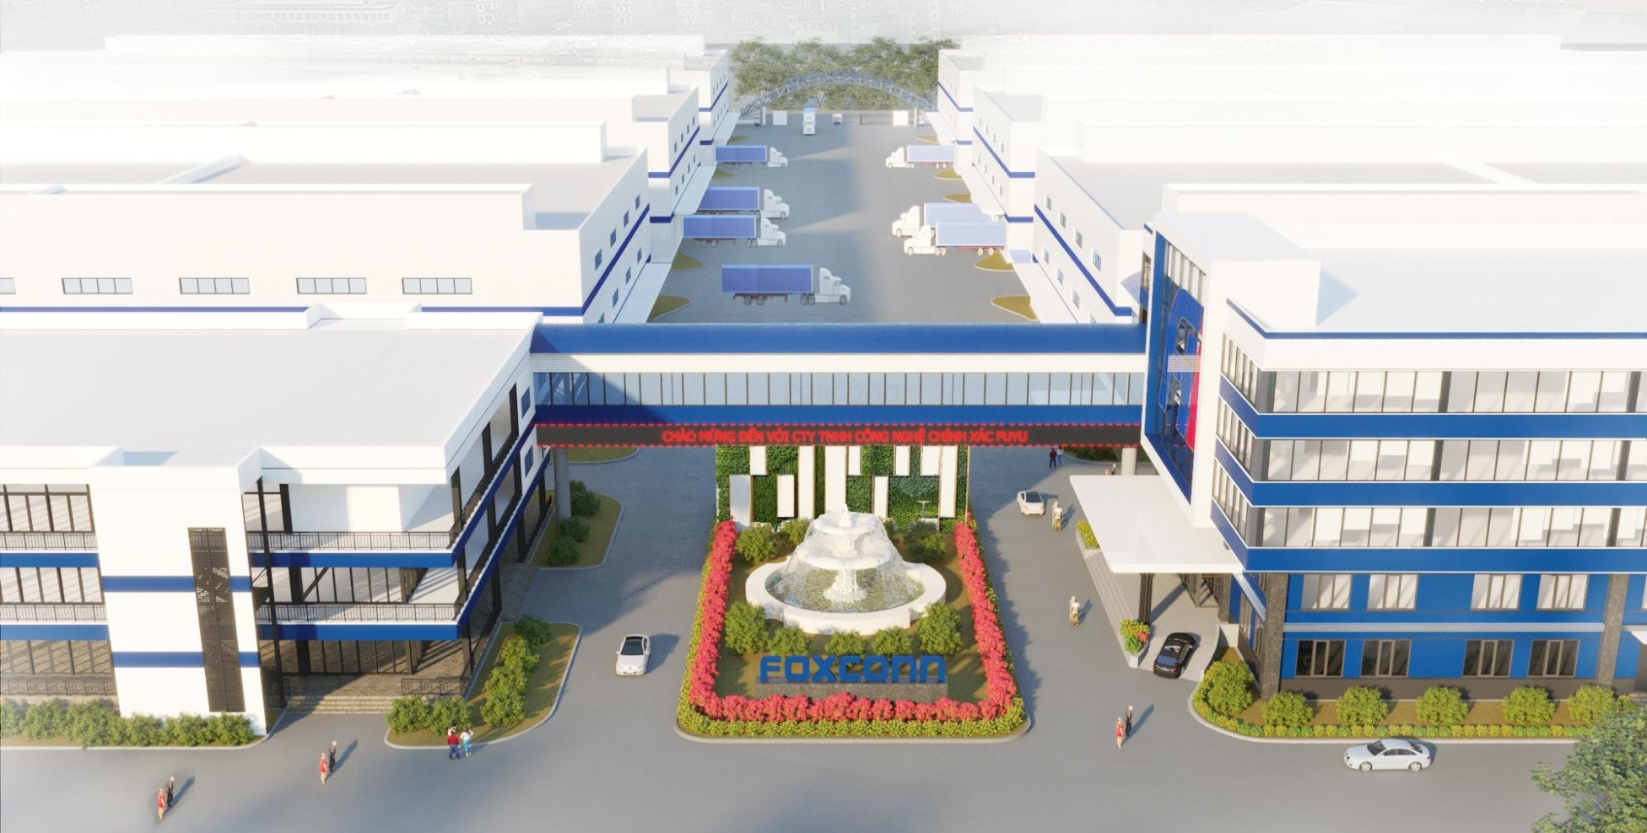



Fii Vietnam History (2/2)
Established Camera Product Line
2016
Entered the outdoor camera
The Vietnam RD Center was established in Bac Ninh factory. The first phase of STB/GPON was developed and deployed for the Southeast Asian market.
2017
Start of in Bac Ninh
G-Group officially entered in Bac Ninh factory to produce high end cable modem products. Start build and arrange shipment of new products Mesh/IP Camera/Base Terminal station.
2018
Expansion in Que Vo, Bac Ninh
Two factories were established in Bac Ninh Plant, entering the field of Mesh and mobile communication base station system modules production.
2019
Expansion in Quang Chau
Switch/OTT production capacity expansion.
2020
First Lot 5G product NPI and shipment
Expansion in Quang Chau in Zone T1*88000m2; CN1&2*480,000m2
We are focusing to develop on High End Cable Modem, GPON, 5G and 6G devices
Zone T1 (Open*4 Building)
2023
Zone CN1&2

Slide 18
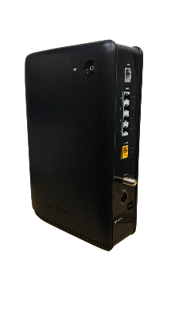




Fii Vietnam Products Portfolio and Capacity
VIETNAM PRODUCT PORTFOLIO
2022 Fii VN BUILD PRODUCTS
Million units
SET TOP BOX
CABLE MODEM
WIFI/MESH
ROUTER
GPON
4G/5G ODU/IDU
SWITCH
BASE TERMINAL
FII SITE CAPACITY
SITE CAPACITY |  | SMT Lines | Daily | Monthly
 |  |  | Kpcs | Kpcs
SMT | Bac Ninh | 48 | 113 | 3,000
Capacity | Bac Giang | 108 | 310 | 8,400
 | Total | 156 | 423 | 11,400
SMART METER
IP CAMERA
WIFI & MOBILE
MODULE
There are total 156 SMT lines in VN and capacity can reach up to 11.4 million units per month.

Slide 19
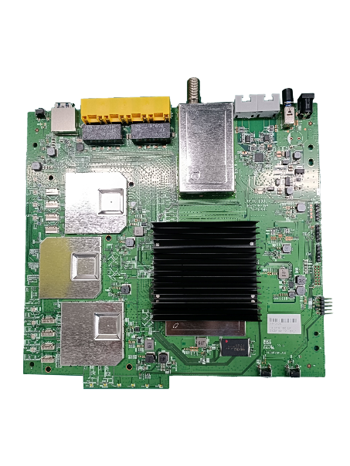
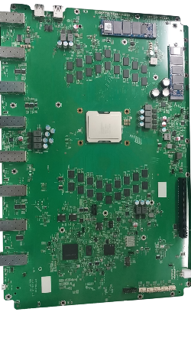








Fii VN SMT Capability - Progress
Chip mount experience (High speed): Accuracy +/- 0.04mm
IC mount experience (Universal): Accuracy +/- 0.03mm
PCBA experience as below record:
Switch/BTS board
Cable modem
PCB thickness: 3.5-6.3mm
Chip Size: 01005
WLCSP: 0.3pitch
Size: 710*580mm
Set-top box/PON
Fire TV (4K)
PCB thickness:1.0-2.0mm
Chip size:0201
CSP Pitch:0.4pitch
Size: 127*124mm
PCB thickness:1.2-2.0mm
Chip size:0201
CSP Pitch:0.4pitch
Size: 162*116mm
Camera Board
Rigid-flex Board
PCB thickness: 1.2-1.6mm
Chip Size: 0201
WLCSP: 0.3pitch
Size:91*30mm
PCB thickness: 0.6-1.2mm
Chip Size: 0201
CSP: 0.4pitch
Size:65*45mm
PCB thickness: 0.3-1.0mm
Chip Size: 0201
CSP: 0.4pitch
Size: 95*11mm

Slide 20







Fii Test Capabilities Overview
ODM
Test strategy
JDM
Test SW&HW development
CM
DFX, Debug, Measurement,Test setup& Maintenance.. etc

Slide 21




















Engineering Service Introduction
NPI
Design For Service (DFx)
Design For Manufacturing (DFM)
Design For Testing (DFT)
Design For Reliability (DFR)
Pro Engineer is a solid/3D
MiniTab15 is used to improve quality FA
DFM Center system
Valor Trilogy for PCB programming
FABmaster is for assisting architects
Automation Competency
Fixture Design / Development
CCD inspection
Robot automatic test
XY Table automatic test
Design
Manufacturing
Application
Solder paste fixture
Laser engraving machine
Testing fixture
Value Engineering
SMT / PTH / Assembly
Package Design
AGV
High speed mounter
Wave solder AOI
Auto Box-folding

Slide 22
About Foxconn Industrial Internet
Foxconn Vietnam Introduction
Quality Control
AGENDA
Supply Chain and Logistic Overview
Foxconn Vietnam CSR

Slide 23
Fii : Production Process and System control
MO
Material
Preparing
SPI
SMT
AOI
DIP
Wave Soldering
A
SAP links to SFIS
SFIS control
F/W programming
Label printing
100% testing
100% check
Stick/Scan barcode
label
Speed:0.13 sec/chip
Chip size: 01005
CSP/BGA :0.5mm
QFP:0.4mm
100% testing for the cover rate of solder paste on the materials
IQC
IPQC
VI for normal information such as:
label, MPN, ROHS,…
Date code
Qualified Vendor
Sizes for cosmetic materials
Functions for electronic materials
4M 1E controlling during production process
A
Function
Test
Housing Assembly
Packing
OBA
Warehouse
Shipment
Cosmetic inspection
Check accessories
Power on/Power off.
Check all functions
VI for PCBA installation into housing
VI for housing assembling into housing
Configuration check
AQL 0.65
Cosmetic inspection
Check accessory, label, box, carton…
Check all functions
SFIS link
Check DUT Alive
Check Version
Check SN
All device function test
Battery, LED, Buttons, Ethernet check
VoIP, Doccis 3.0, Doccis 3.1
IPQC
CQA
LDB check
Container seal check
VI for outside pallet
Cross checking/scanning for CQA & FG shipping data
4M 1E controlling during production process
Shop Floor Integrated System
All parts System
Raw Material Traceability
Product Traceability

Slide 24

















Technical & Engineering Service – Common Pool Lab
Wireless Test Lab
@ HC, NN
LTE UE GCF/PTCRB pre-test
LTE VoLTE core network
Small cell stress test
RF EDVT
SQA/ System Lab
@ LH, HY, NN, TJ, SH, HC, TC
System integration test
Full load system level stress test
Interoperability test
SDN, Open stack validation
Performance test
COMMON
POOL
LAB
Signal Integrated Lab
@HY, TJ, HC, LH, NN, SH, VN
High speed signal integrated validation
DDR4, SATA4, USB3.1, HDMI2.1, 802.3…
Reliability Test Lab
@LH, HY, NN, TJ, SH, VN
Reliability test, Mechanical test
Accredited by CNAS
HALT chambers
Shock/Vibration test
Failure analysis lab
RF Lab
@HC
MIMO OTA Chamber for sub6G
OTA performance test, CTIA 3.6
CWG-RF, CTIA v2.0.3
MIMO-TM2/TM2, CTIA v1.1
Antenna TIS/TRP
Regulatory Lab
@LH, HY, TC, NN
International regulatory test
Accredited by CNAS, FCC, UL…
EPA approved for Energy Start
Camera Lab
@HC, VN
Camera/IQ Studio
Camera image quality validation
Various light sources for AE/AW
Lens test capability
Field of view measurement
Acoustics Lab
@HC, VN
Speaker/Microphone Test Lab
Anechoic chamber
Ambient noise < 15dBa
TIA-810/910, ETSI

Slide 25















VN QA Lab Capability
RF & SI & 3D(ME)
HDMI 1.4
DDRI/II/III/IV
PCI-E 1.0/1.1/2.0/3.0
2C Timing Test
Flash Timing Test
MDIO/MII/SDIO/GPIO/SPI/UART
Battery Charge Test ( N6705B)
3 D Measurement, object flatness /space, 10X~1000X
2.4GHz &5GHz Tx /Rx /LNA/Noise Figure, S- Parameters & K – Factor
MDVT
Optics/Image
Resolution
Chromatic Aberration
Auto White Balance
Color Fidelity
Saturation
Spatial SNR
Dynamic Range
Lens Shading
Color Shading
Distortion
Auto Exposure
FOV
Vibration Machine
Range: 1~2000Hz
Thermal Shock
Range: -65~150^{O}C
Drop test Machine
Range: 0 ~ 1500mm
Drop Tester
Test height: 30~130cm
Test weight: <60kg.
Burn in Chamber
Acoustics
Sound Pressure Level
Frequency Response
Total harmonic distortion
Recording level
Total harmonic distortion with noise
Temp & Humid Chamber
Temp. Range :-40℃-120℃
Solder ability Test
Temp & Humid Chamber
Temp. Range :-70℃-150℃
Thermal Cycling Chamber
Temp. Range :-55℃-150℃
Temp variation: 3~25℃/min
Cross Sectioning Machine
Model: Struers
Temp & Humid Chamber
Temp. Range : -60℃-150℃
Humid: 0%，5%-98%
Dye & Pry

Slide 26






Fii Vietnam Compliance & Certification
ISO
9001
ISO
45001
ESD
20.20
SA
8000
TL
9000
ISO
14001

Slide 27
About Foxconn Industrial Internet
Foxconn Vietnam Introduction
Quality Control
AGENDA
Supply Chain and Logistic Overview
Foxconn Vietnam CSR

Slide 28












SCM - Inbound & Outbound Logistics Strength
OVERSEA VENDOR
Ping Xiang Bounded Logistic
Import/export Custom declaration
Original custom (Bac Giang) | Opening time Mon ~ Friday 8:00~12:00 13:00~ 17:00 Saturday 8:00~12:00 | Sea shipment – 10.5 hour Air shipment – 8 hour Truck shipment – 10 hour It could process before material delivery
Sea (Hai phong) | Opening time Mon ~ Friday 8:00~12:00 13:00~ 17:00 | 5 hour
Air (Hanoi) |  | 3 hour
Truck |  | 7 hour
HK forwarder
2 – 7 days
26 hrs
E&E
3 hrs
5 – 7 days
2 days
Vietnam
Boarder
Shield, connector, heatsink, PSU, cable
3 hrs
Customer Site
Via Haiphong
VN Factory
Haiphong Port
2 – 3.5 hrs
5 – 7 days
LOCAL VENDOR
1hrs
Noi Bai Airport
JIT
Remark | Type | Frequency | By Sea | By Truck | By Air
 | Inbound | Daily | 7days | 2days | 2days
 | Outbound | Daily | US: 21~24days EU: 29~31days | N/A | US/EU: 3~5days
Package & housing
Notes:
Check for local vendor

Slide 29





Outbound Logistics
Hanoi airport
Customer
Air shipment
FVN
Truck Shipment
0.5 day
VN Customs Declaration
0.5 day
Hong Kong(3 day)
Customer
Sea shipment
Haiphong port

Slide 30
About Foxconn Industrial Internet
Foxconn Vietnam Introduction
Quality Control
AGENDA
Supply Chain and Logistic Overview
Foxconn Vietnam CSR

Slide 31











Fii Vietnam – CSR Activities in Vietnam
1. To be a member of RBA, Foxconn strictly follows our business theory “HUMAN IS CORE”. Caring for every employee’s life, Foxconn regularly organize entertainment activities to improve employee’s life during their free time.
2. Foxconn Group focus on employee’s training and support with the Foxconn scholarship program the best employee for oversea studies.
3. For a long time, Foxconn Group in Vietnam has arranging many activities for our employees annually, such as The Voice of Foxconn, The Unity Festival, Miss Foxconn, Foxconn Team Building,…
Vietnam employees get to go for Master Degree in Taiwan once a year
Annual The Voice of Foxconn
Annual The Unity Festival
Annual Miss Foxconn
Annual Foxconn Team Building
Fii Football Champions League is always one of the most anticipated event, which are held weekly and monthly

Slide 32

Foxconn Group – ESG Philosophy
Hon Hai Technology Group, or Foxconn, has been operating under the guideline of “Sustainable Management = EPS+ESG since 2020. The Group has formulated development strategies and implemented new measures while reducing energy consumption and carbon emissions through innovative technologies based on rigorous standards in response to climate issues yet is still simultaneously active in participation of Carbon Disclosure project and Climate Action 100+, pledging to achieve a target of Zero Emissions by 2050.

Slide 33


Slide 34


